Slide 1

Exploring Multimodal Large Language Models for Medical Image Captioning
Marina Samprovalaki
MSc in Computer Science
Department of Informatics
Athens University of Economics and Business
Athens, Greece
Supervisors: Ion Androutsopoulos, John Pavlopoulos

Slide 2

Outline
Introduction
Dataset & Evaluation Metrics
Methods
  Supervised Fine Tuning and Few Shot Examples
    Instruction Tuning
    InstructBLIP
    LLaVA-1.5
  Synthesizer
    Embeddings Model
    Neighbors Retrieval
    Llama 3.1
  Ensembling
    LM - Fuser
Conclusion & Future Work

Slide 3
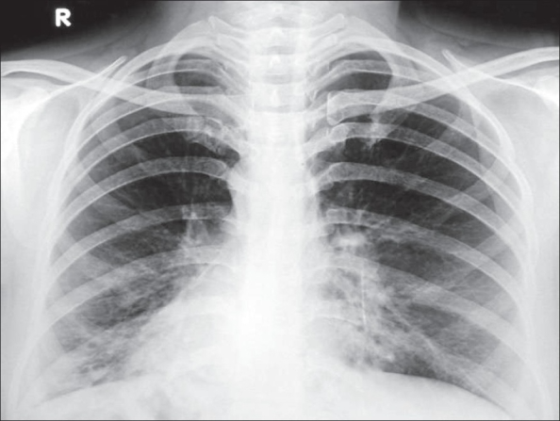
Introduction (1/2)
Task: Diagnostic Captioning
Goal: Given a medical image, generate a caption highlighting medical information about a patient
chest radiograph pa view

Slide 4
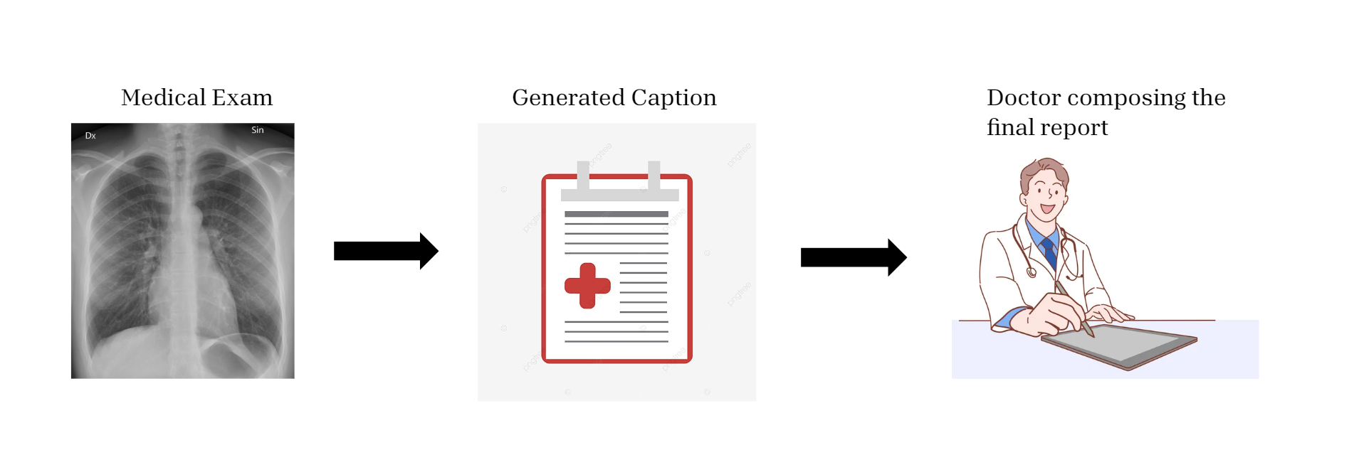
Introduction (2/2)
Methods: Aiming to Assist, Not Replace Medical Professionals
Most Experienced Clinicians
  Enhancing efficiency and helping manage more patients in less time.
Less Experienced Clinicians
  Reducing the likelihood of errors and providing support in decision-making.

Slide 5
Outline
Introduction
Dataset & Evaluation Metrics
Methods
  Supervised Fine Tuning and Few Shot Examples
    Instruction Tuning
    InstructBLIP
    LLaVA-1.5
  Synthesizer
    Embeddings Model
    Neighbors Retrieval
    Llama 3.1
  Ensembling
    LM - Fuser
Conclusion & Future Work

Slide 6
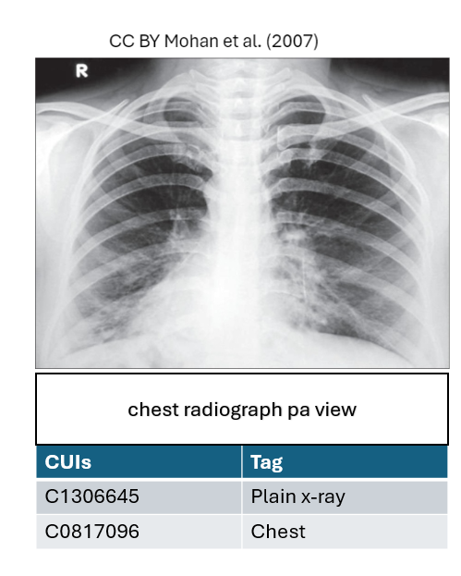
Dataset
ImageCLEF is an annual campaign focused on promoting AI advancements in the biomedical domain.
Concept Detection and Caption Prediction sub-tasks.
2nd in Concept Detection, 4th in Caption Prediction
The ImageCLEFmedical 2024 dataset was utilized throughout this thesis, comprising 80,080 medical images (e.g., X-rays, MRIs, CT scans, etc.).
  Each image is associated with a diagnostic caption.
  Each image is also associated with one or more biomedical concept (tag)
The data was split into training (70%), validation (15%) and development (15%) sets.
  An official test set was also released consisting of 17,237 images

Slide 7
Evaluation Metrics
BLEU
ROUGE-L
BERTScore
BLEURT
They measure the lexical overlap between the generated sequence and the ground truth sequence.
They are capable of capturing the contextual similarity between two text sequences.

Slide 8
Outline
Introduction
Dataset & Evaluation Metrics
Methods
  Supervised Fine Tuning and Few Shot Examples
    Instruction Tuning
    InstructBLIP
    LLaVA-1.5
  Synthesizer
    Embeddings Model
    Neighbors Retrieval
    Llama 3.1
  Ensembling
    LM - Fuser
Conclusion & Future Work

Slide 9
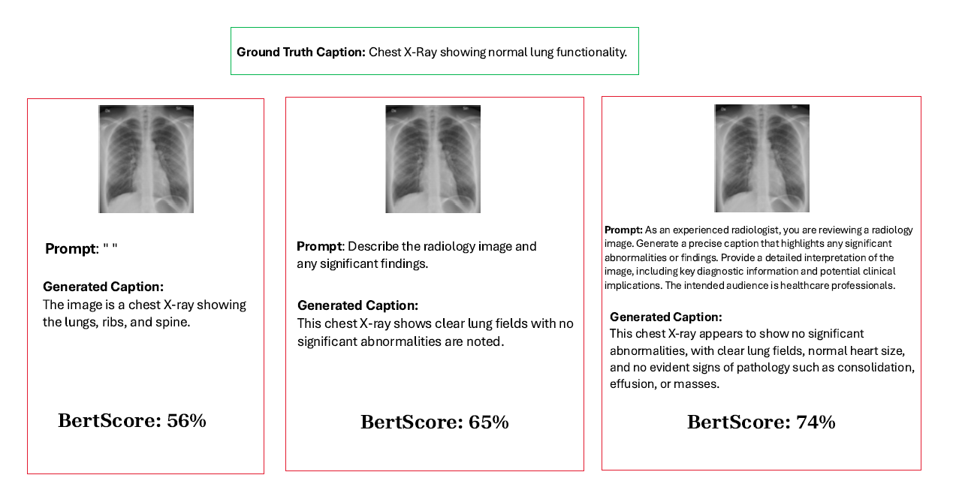
Instruction Tuning (1/2)

Slide 10
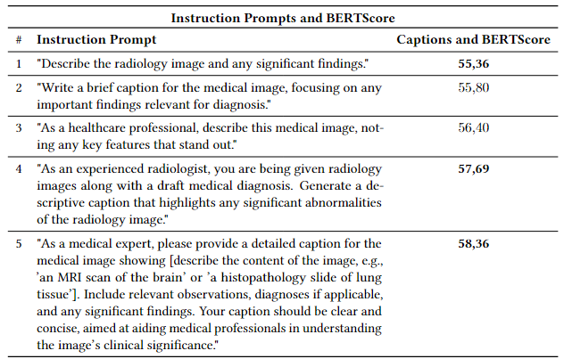
Instruction Tuning (2/2)

Slide 11
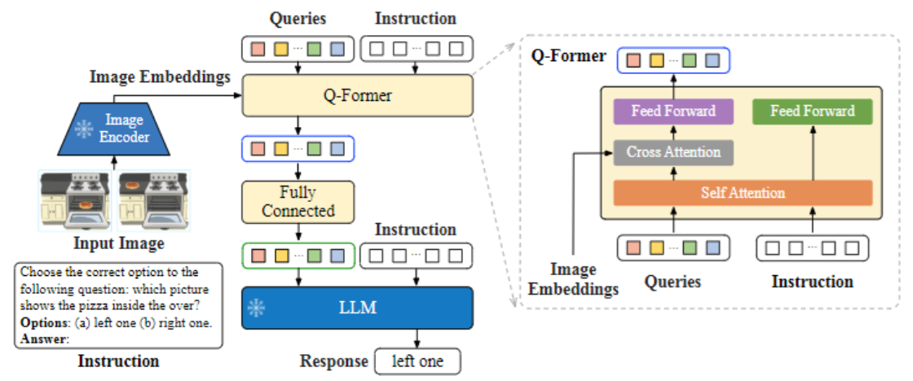
InstructBLIP
Visual Language Model (VLM): This architecture combines image embeddings and language instructions to perform tasks like visual question answering, making it a multimodal system that handles both visual and textual inputs.
Image Encoder: Converts input images into embeddings to be used by the Q-Former module for processing.
Q-Former Role: It processes queries and instructions, integrating image embeddings to generate responses via a combination of cross-attention and self-attention layers.
Large Language Model (LLM): The LLM processes the combined outputs from the Q-Former to generate the final response, enabling the system to understand and respond to queries based on both visual and textual information.
Figure taken from Dai et al. “InstructBLIP: Towards General-purpose Vision-Language Models with Instruction Tuning” (2023)

Slide 12
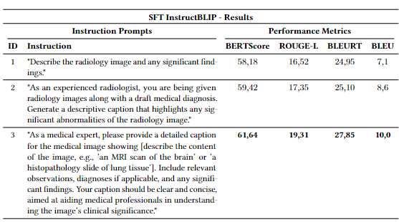
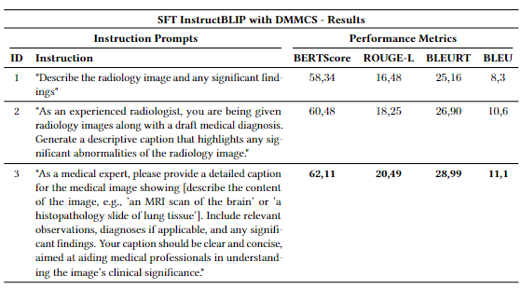
InstructBLIP – Experiments
P. Kaliosis et al. “A Data-Driven Guided Decoding Mechanism for Diagnostic Captioning”, ACL 2024

Slide 13
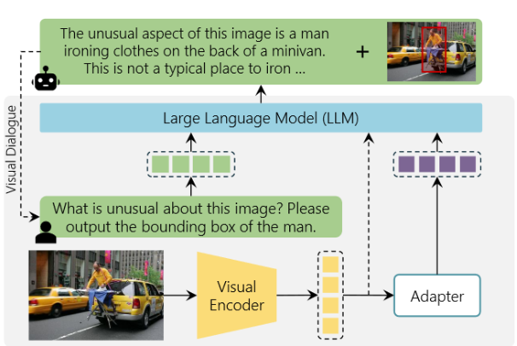
Multimodal LLMs
Models that process multiple types of inputs, not only text or images but additional modalities as well.
Multimodal LLMs integrate an encoder, a large language model (LLM), and an adaptor that connects them.
Fine-tuning involves two steps:
  Pre-training on a large corpus to acquire general knowledge.
  Instruction Tuning on prompts designed for specific tasks.
Figure taken from Caffagni et al. “The Revolution of Multi-modal Large Language Models: A Survey” (2024)

Slide 14
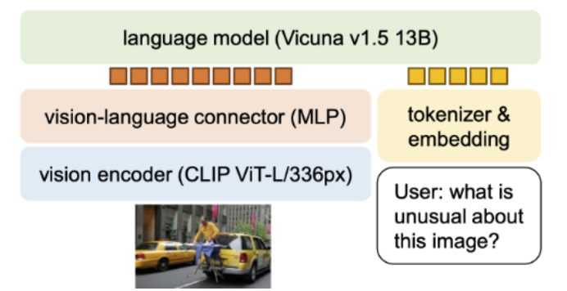
LLaVA-1.5
Builds upon the original LLaVA model, improving data efficiency and robustness.
Vicuna as the LLM: The same language model as in the original LLaVA.
Key Improvements:
  High-Resolution Processing: Uses CLIP-ViT-L-336px encoder.
  2-layer MLP: Aligns outputs from the vision encoder and language model in a shared space, enhancing integration.
Figure taken from Liu et al. “Improved Baselines with Visual Instruction Tuning” (2024)

Slide 15
QLoRA: Efficient Fine-Tuning of Large Language Models
Reduces Computational Requirements:
Instead of updating the entire model, we updates only a small, low-rank approximation of the model’s weights.
Quantization for Memory Efficiency:
The model’s weights are quantized (e.g., from 32-bit to 8-bit precision), which reduces memory usage and speeds up computations.
Performance:
Maintains competitiveness even with quantization.

Slide 16
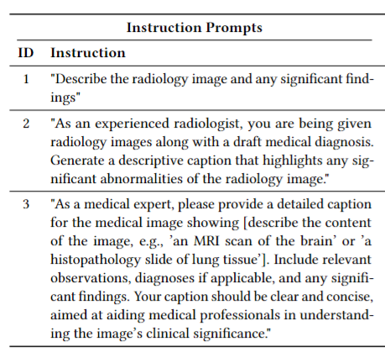
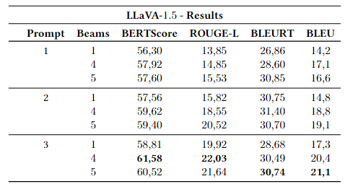
SFT LLaVA-1.5 – Tuning Beam Width

Slide 17
SFT LLaVA-1.5 - Experiments
Model | BertScore | ROUGE-L | BLEURT | BLEU
InstructBLIP - Baseline | 61.64 | 19.31 | 27.85 | 10.0
InstructBLIP w DMMCS | 62.11 | 20.49 | 28.99 | 11.1
SFT LLaVA-1.5 | 62.08 | 22.53 | 30.99 | 20.6
SFT LLaVA-1.5 w DMMCS | 61.90 | 21.80 | 29.12 | 20.8

Slide 18
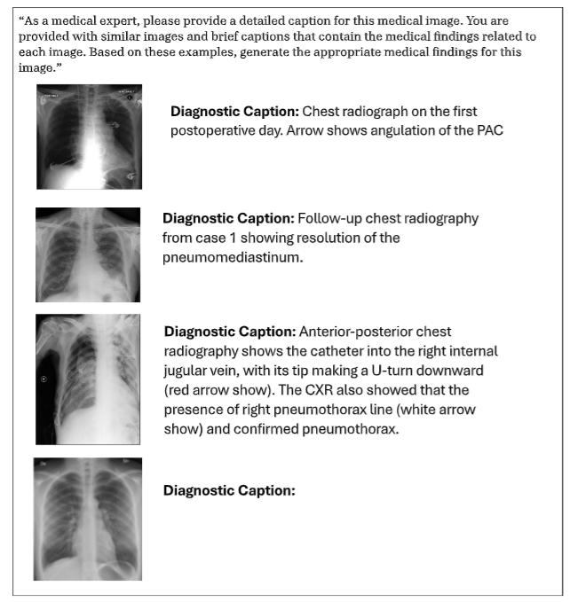
LLaVA-1.5 – Few Shot Examples
In-Context Learning: LLMs have the ability to adapt and perform specific tasks based on the context provided in a prompt, without requiring explicit fine-tuning.
A common approach involves retrieving the k nearest neighbors and utilizing them as few-shot examples.
Not costly in terms of computation or time.

Slide 19
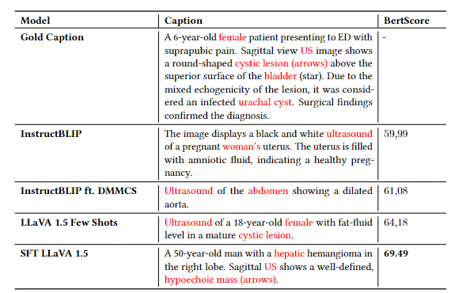
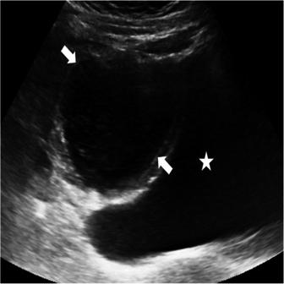
Quantitative Results

Slide 20
LLaVA-1.5 Few Shot - Experimental Results
Model | BertScore | ROUGE-L | BLEURT | BLEU
InstructBLIP - Baseline | 61.64 | 19.31 | 27.85 | 10.0
InstructBLIP w DMMCS | 62.11 | 20.49 | 28.99 | 11.1
SFT LLaVA-1.5 w DMMCS | 61.90 | 21.80 | 29.12 | 20.8
LLaVA-1.5 Few Shots | 59.02 | 20.60 | 28.25 | 17.6
SFT LLaVA-1.5 | 62.08 | 22.53 | 30.99 | 20.6

Slide 21
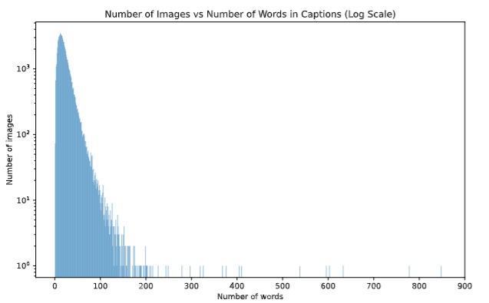
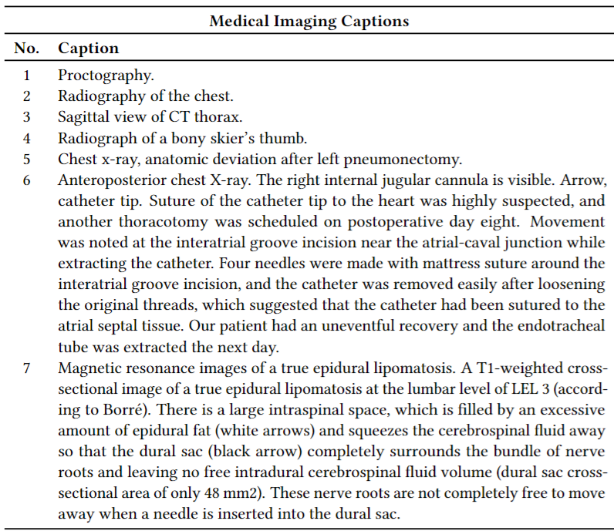
Dataset with Varying Caption Lengths

Slide 22
Outline
Introduction
Dataset & Evaluation Metrics
Methods
  Supervised Fine Tuning and Few Shot Examples
    Instruction Tuning
    InstructBLIP
    LLaVA-1.5
  Synthesizer
    Embeddings Model
    Neighbors Retrieval
    Llama 3.1
  Ensembling
    LM - Fuser
Conclusion & Future Work

Slide 23
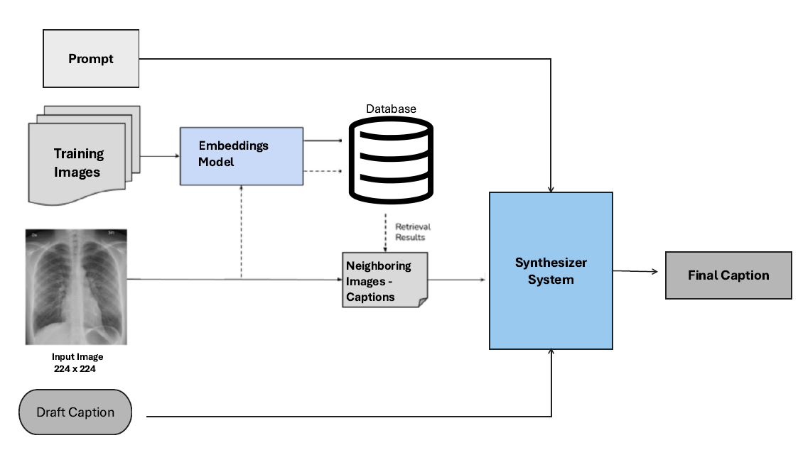
Synthesizer

Slide 24
Steps (1/5) – Draft Caption
Model | BertScore | ROUGE-L | BLEURT | BLEU
InstructBLIP w DMMCS | 62.11 | 20.49 | 28.99 | 11.1
SFT LLaVA-1.5 | 62.08 | 22.53 | 30.99 | 20.6

Slide 25
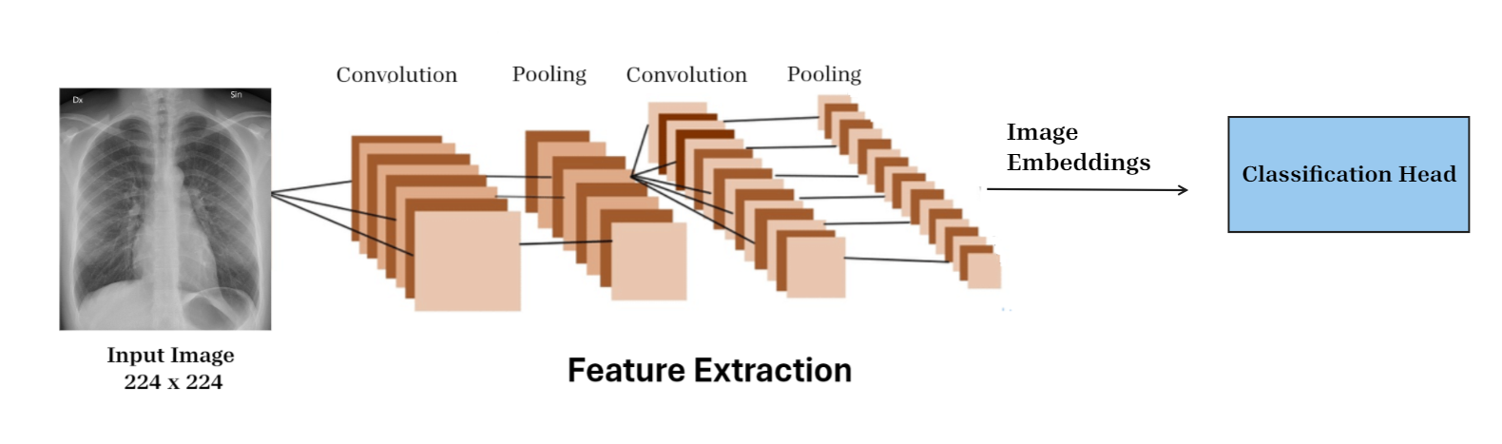
Steps (2/5) - Image Embeddings

Slide 26
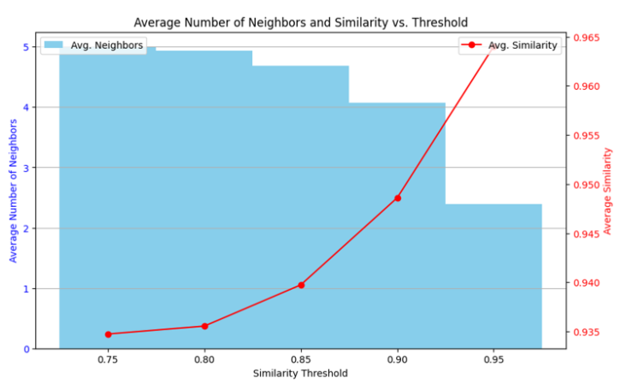
Steps (3/5) - Image Similarity Percentage

Slide 27
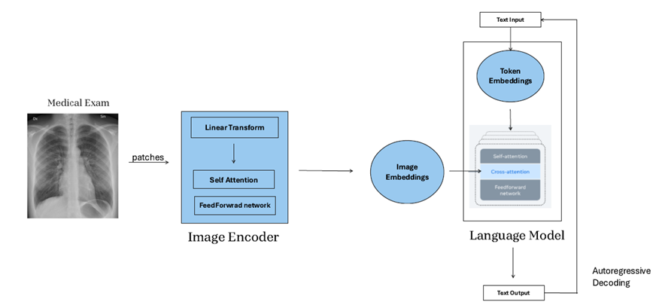
Step (4/5) - Llama 3.1 Instruct 8B
A collection of multilingual text-to-text large language models (LLMs).
Initially not multimodal, with numerous experiments conducted using the encoder and LLM independently.
Fine-tuned using supervised methods and reinforcement learning from human feedback (RLHF) to align with human preferences.

Slide 28
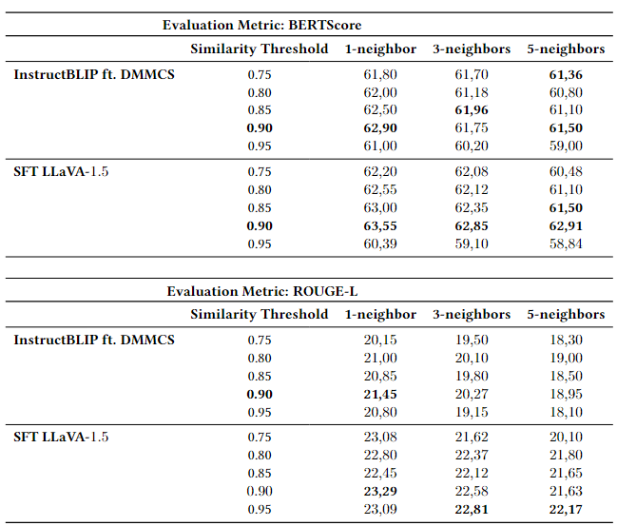
Steps (5/5) – Total Neighbors

Slide 29
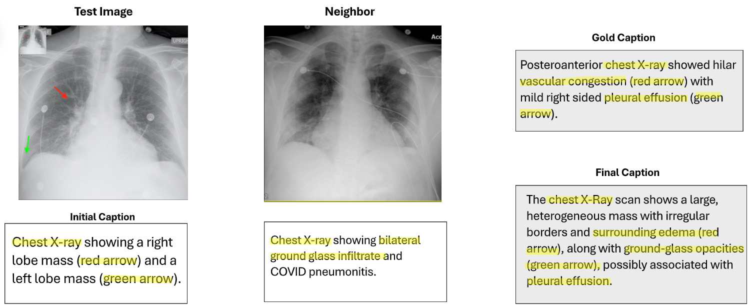

Synthesizer - Quantitative Results

Slide 30
Synthesizer - Experimental Results
Model | BertScore | ROUGE-L | BLEURT | BLEU
InstructBLIP - Baseline | 61.64 | 19.31 | 27.85 | 10.0
InstructBLIP w DMMCS | 62.11 | 20.49 | 28.99 | 11.1
LLaVA-1.5 Few Shots | 59.02 | 20.60 | 28.25 | 17.6
SFT LLaVA-1.5 w DMMCS | 61.90 | 21.80 | 29.12 | 20.8
SFT LLaVA-1.5 | 62.08 | 22.53 | 30.99 | 20.6
Synthesizer | 63.55 | 23.29 | 32.44 | 21.7

Slide 31
Outline
Introduction
Dataset & Evaluation Metrics
Methods
  Supervised Fine Tuning and Few Shot Examples
    Instruction Tuning
    InstructBLIP
    LLaVA-1.5
  Synthesizer
    Embeddings Model
    Neighbors Retrieval
    Llama 3.1
  Ensembling
    LM - Fuser
Conclusion & Future Work

Slide 32
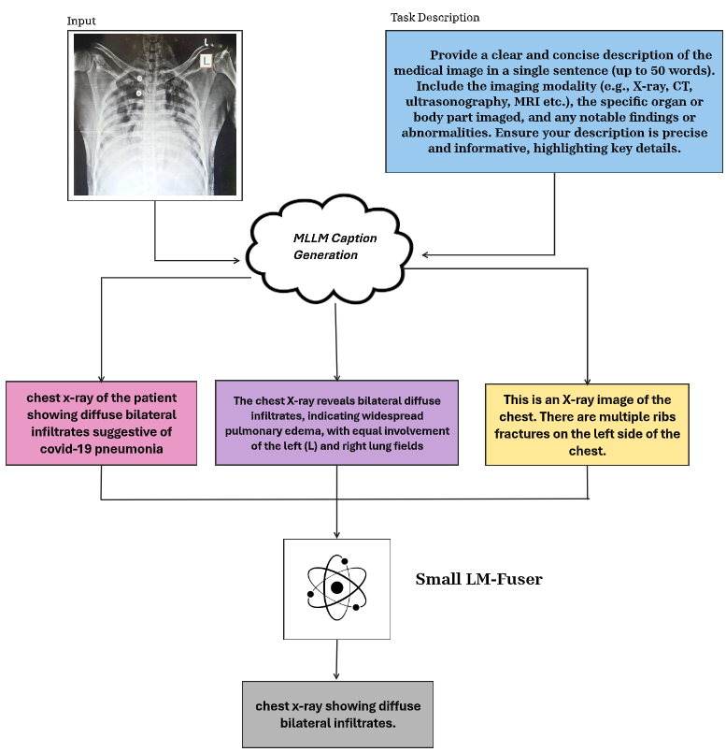
LM-Fuser

Slide 33
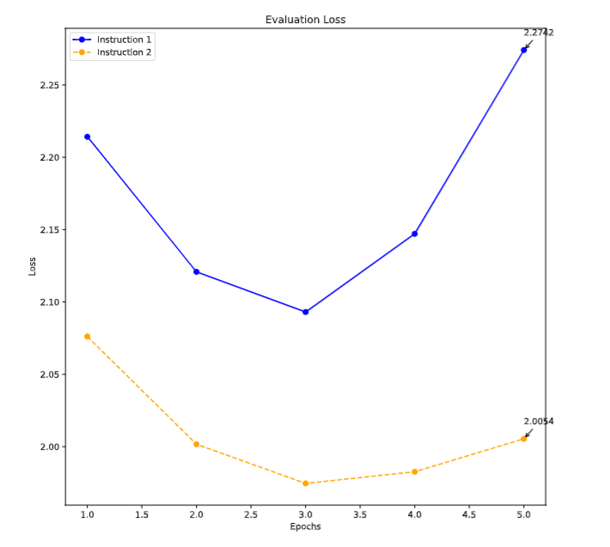
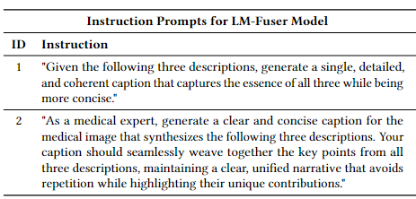
LM-Fuser – Training Process

Slide 34
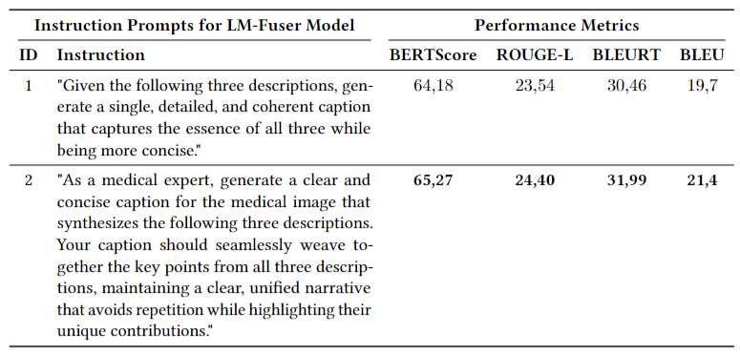
LM-Fuser – Validation Set Results

Slide 35
LM-Fuser - Experimental Results
Model | BertScore | ROUGE-L | BLEURT | BLEU
InstructBLIP - Baseline | 61.64 | 19.31 | 27.85 | 10.0
InstructBLIP w DMMCS | 62.11 | 20.49 | 28.99 | 11.1
LLaVA-1.5 Few Shots | 59.02 | 20.60 | 28.25 | 17.6
SFT LLaVA-1.5 w DMMCS | 61.90 | 21.80 | 29.12 | 20.8
SFT LLaVA-1.5 | 62.08 | 22.53 | 30.99 | 20.6
Synthesizer | 63.55 | 23.29 | 32.44 | 21.7
LM-Fuser | 64.27 | 24.40 | 31.99 | 20.4

Slide 36
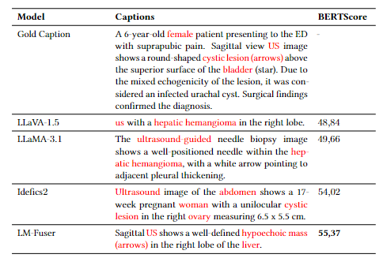
LM-Fuser - Quantitative Results

Slide 37
Outline
Introduction
Dataset & Evaluation Metrics
Methods
  Supervised Fine Tuning and Few Shot Examples
    Instruction Tuning
    InstructBLIP
    LLaVA-1.5
  Synthesizer
    Embeddings Model
    Neighbors Retrieval
    Llama 3.1
  Ensembling
    LM - Fuser
Conclusion & Future Work

Slide 38
Conclusion & Future Work
Multimodal Large Language Models (MLLMs) were fine-tuned using quantization to enhance hardware efficiency and employed few-shot learning, demonstrating their ability to effectively extract critical details from image inputs.
Similar images (e.g., based on modality or organ) can improve caption quality.
Integrate captions generated by multiple MLLMs produces more concise.
Hallucinations still a challenge.
However, still far from gold caption accuracy.
Future Work:
  Collaborate with clinicians to enhance evaluation metrics, identify impactful prompts, and refine the model using techniques like RLHF to embed their expertise.
  Manage the generation process to ensure precise control and meaningful influence over the model's outputs.
  Investigate the effect of weight averaging and ranking in the LM-Fuser.

Slide 39


